Slide 3
Python Classes/Objects
Python is an object oriented programming language.
Almost everything in Python is an object, with its properties and methods.
A Class is like an object constructor, or a "blueprint" for creating objects.
Create a Class
To create a class, use the keyword class:

Slide 4

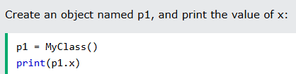

Slide 5
The __init__() Function
All classes have a function called __init__(), which is always executed when the class is being initiated.

Slide 6
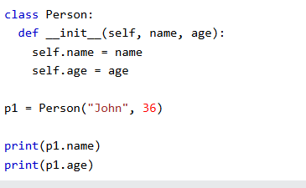
The __init__() function is called automatically every time the class is being used to create a new object.

Slide 7
The __str__() Function
The __str__() function controls what should be returned when the class object is represented as a string.

Slide 8
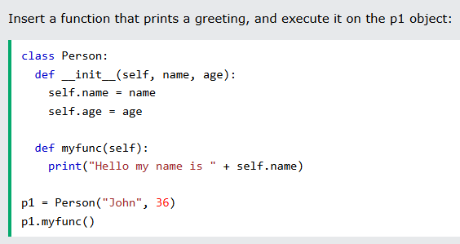

Slide 9
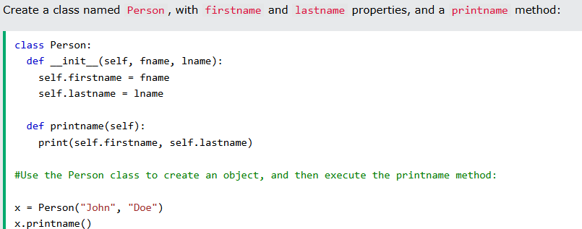

Slide 10
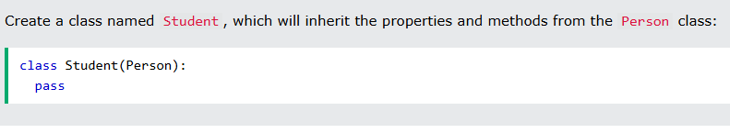
Note: Use the pass keyword when you do not want to add any other properties or methods to the class.

Slide 11
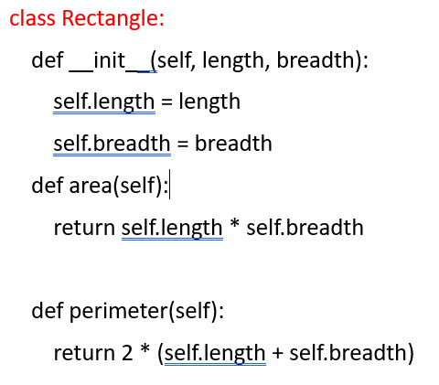
Create a rectangle class with attributes and methods to calculate area and perimeter

Slide 12
rect = Rectangle(5, 3)
print("Area:", rect.area())
print("Perimeter:", rect.perimeter())

Slide 13
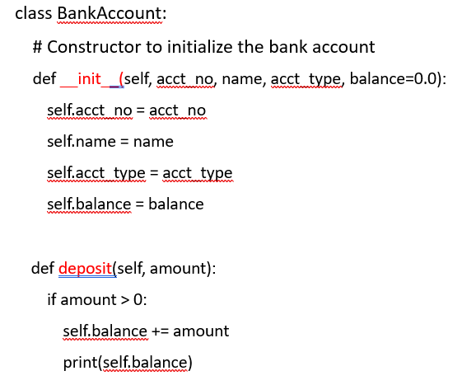

Slide 14
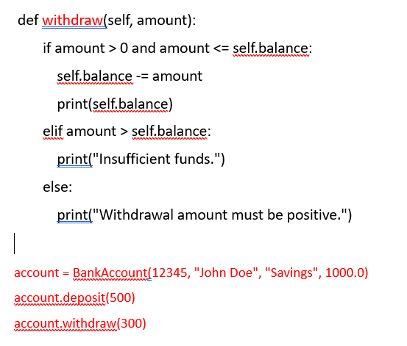

Slide 15
Create Class rectangle with private attribute length and breadth overload ‘< ‘operator
class Rectangle:
# Constructor to initialize the rectangle with length and breadth
def __init__(self, length, breadth):
self.__length = length # Private attribute for length
self.__breadth = breadth # Private attribute for breadth
def get_length(self):
return self.__length
def get_breadth(self):
return self.__breadth
def area(self):
return self.__length * self.__breadth

Slide 16
def __lt__(self, other):
if isinstance(other, Rectangle):
return self.area() < other.area()
return NotImplemented
def display(self):
print(f"Rectangle(length={self.__length}, breadth={self.__breadth}, area={self.area()})")

Slide 17
EXAMPLE
rect1 = Rectangle(5, 3) # Area = 15
rect2 = Rectangle(4, 4) # Area = 16
if rect1 < rect2:
print("rect1 is smaller than rect2 based on area.")
else:
print("rect1 is not smaller than rect2 based on area.")
rect1.display()
rect2.display()
OUTPUT
rect1 is smaller than rect2 based on area.
Rectangle(length=5, breadth=3, area=15)
Rectangle(length=4, breadth=4, area=16)

Slide 18
create a class time with private attribute hour,minute and second. overload '+' opertor to find sum of 2 time
class Time:
def __init__(self, hour=0, minute=0, second=0):
self.__hour = hour
self.__minute = minute
self.__second = second
def get_hour(self):
return self.__hour
def get_minute(self):
return self.__minute
def get_second(self):
return self.__second
def display(self): # Method to display time in HH:MM:SS format
print(f"{self.__hour:02}:{self.__minute:02}:{self.__second:02}")

Slide 19
# Overload the + operator to add two Time objects
def __add__(self, other):
if isinstance(other, Time):
# Sum seconds, minutes, and hours
total_seconds = self.__second + other.__second
total_minutes = self.__minute + other.__minute + total_seconds // 60
total_hours = self.__hour + other.__hour + total_minutes // 60
# Adjust seconds, minutes, and hours
total_seconds %= 60
total_minutes %= 60
total_hours %= 24 # Assuming a 24-hour clock
return Time(total_hours, total_minutes, total_seconds)
return NotImplemented

Slide 20
EXAMPLE
time1 = Time(5, 45, 30) # 5 hours, 45 minutes, 30 seconds
time2 = Time(3, 30, 45) # 3 hours, 30 minutes, 45 seconds
result_time = time1 + time2
result_time.display() # Expected output: 09:16:15 (5:45:30 + 3:30:45 = 9:16:15)
OUTPUT
09:16:15

Slide 21
Create a class publisher(name).Derive class book from Publisher with attribute title and author.Derive class python from book with attributes price and no_of_pages.Write a program that displays information about a python book. use base class constructor invocation and method overriding
# Base class Publisher
class Publisher:
def __init__(self, name):
self.name = name # Publisher's name
def display_publisher(self):
# Method to display publisher's information
print(f"Publisher: {self.name}")
# Derived class Book (inherits from Publisher)
class Book(Publisher):
def __init__(self, name, title, author):
# Call the constructor of Publisher using super() to initialize the name
super().__init__(name)
self.title = title # Book's title
self.author = author # Book's author

Slide 22
def display_book(self):
# Method to display book information (title, author)
print(f"Title: {self.title}")
print(f"Author: {self.author}")
# Derived class PythonBook (inherits from Book)
class PythonBook(Book):
def __init__(self, name, title, author, price, no_of_pages):
# Call the constructor of Book using super() to initialize title and author
super().__init__(name, title, author)
self.price = price # Price of the book
self.no_of_pages = no_of_pages # Number of pages in the book
def display(self):
# Method overriding to display information about the PythonBook
self.display_publisher() # Call the base class Publisher's display method
self.display_book() # Call the Book's display method
print(f"Price: ${self.price}")
print(f"Number of Pages: {self.no_of_pages}")

Slide 23
EXAMPLE
python_book = PythonBook("O'Reilly Media", "Learning Python", "Mark Lutz", 45.99, 1600)
# Display all the information about the PythonBook
python_book.display()
OUTPUT
Publisher: O'Reilly Media
Title: Learning Python
Author: Mark Lutz
Price: $45.99
Number of Pages: 1600

